Slide 1
Butcher to consumer product flow
At first livestock will be supplied to butcher from the registered farmers.
Processing will hold. Corresponding steps are:
Slaughtering
Dressing
Preparing the meat
Meat is divided into categories to allow consumers have a wide range of options.
Now product is stored in freezer and listed in the portal.
Consumers will order from our portal. The corresponding UI is given in the next slide.

Slide 2
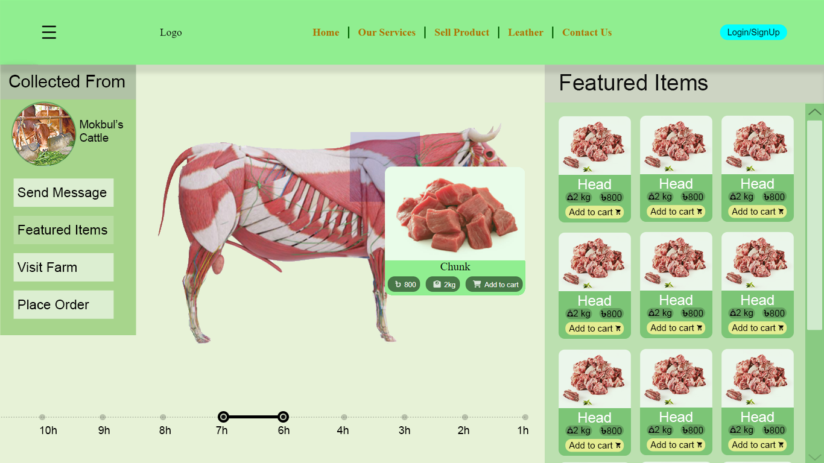

Slide 3
Butcher to Consumer Product flow
Once an order is placed butcher will get a notification and will prepare the ordered meat ensuring proper packaging to maintain freshness of the product.
The meat products are carefully transported to the consumers' specified addresses, maintaining proper temperature control if necessary.
Upon receiving the ordered meat products, consumers can verify the quality, freshness, and adherence to their preferences. They can provide feedback and ratings on the online portal, helping maintain transparency and accountability.

